Slide 1
Civil Technology – Construction GRADE 10
TOPIC: JOINING (GENERIC)
TERM 3 WORK

Slide 2
TOPIC: JOINING (GENERIC)
CONTENT:
IDENTIFY AND EXPLAIN THE USES OF:
1. SCREWS:
Countersunk head,
Round head,
Raised head,
Drywall screw,
1.1 ADVANTAGES OF USING SCREWS OVER NAILS.

Slide 3
TOPIC: JOINING (GENERIC)
CONTENT:
IDENTIFY AND EXPLAIN THE USES OF NAILS:
2. NAILS:
Round wire
Masonry
Cloud nail
Steel cut nail
Oval nail
Panel pin
Clout nail
2.2 ADVANTAGES OF USING NAILS OVER SCREWS

Slide 4
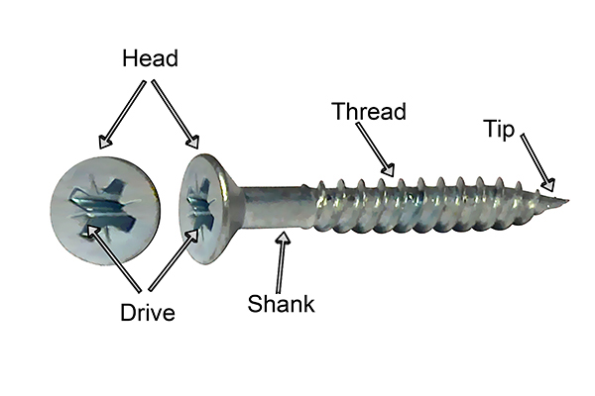
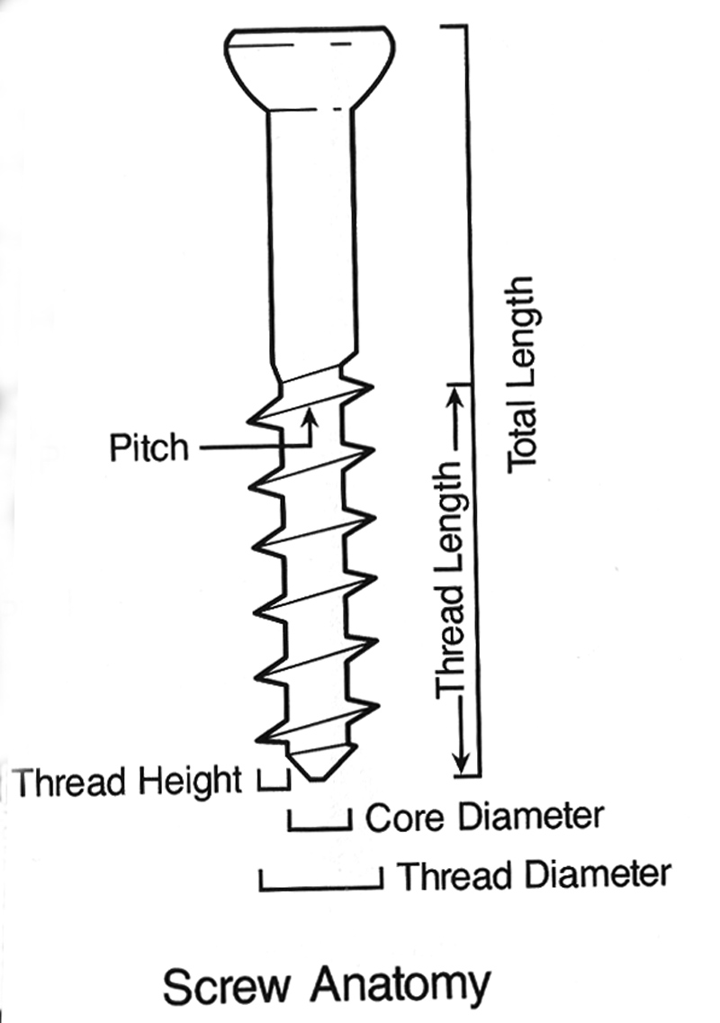
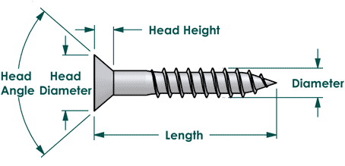
1. Screws: Parts of a screw:

Slide 5
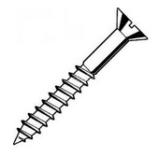
1.1 Countersunk head
Uses:
To hold two pieces of stock together, where the head must not
stand out above the surrounding surface or be visible.
To fix hinges, fittings, etc. to wood where the screw holes are
countersunk

Slide 6
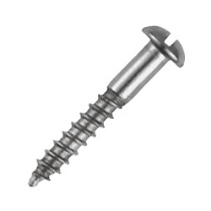
1.2 Round head
Uses:
To hold two pieces of stock together, where the visible head
does not matter.
To fix hinges, fittings, etc. to wood where the screw holes are
no countersunk.

Slide 7
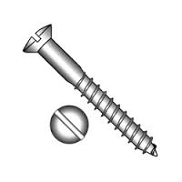
1.3 Raised head
Uses:
To hold two pieces of stock together, where the head does not
stand out above the stock as much as the roundhead screw
does.
To fix hinges, fittings, etc. to wood where the screw holes are
countersunk.

Slide 8
1.5 Drywall screw
Uses:
Black drywall screws have a phosphate coating to resist
corrosion.
The sharp point makes it easier to stab the screw into the
drywall paper and get the screw started.
The bugle head shape helps the screw stay in place, without
tearing all the way through the outer paper layer.

Slide 9
1.1 Advantages of using screws over nails:
Screws have a higher holding ability than nails.
Screws can be removed easier and with less damage than nails.
They can be replaced with less damage than nails.
The shock of driving the nail may damage the work, which is not
the case with screws.
They have a higher holding ability over a longer period of time
than nails.

Slide 10
TOPIC: JOINING (GENERIC)
CONTENT:
IDENTIFY AND EXPLAIN THE USES OF NAILS:
2. NAILS:
Round wire
Masonry
Cloud nail
Steel cut nail
Oval nail
Panel pin
Clout nail
2.2 ADVANTAGES OF USING NAILS OVER SCREWS

Slide 11
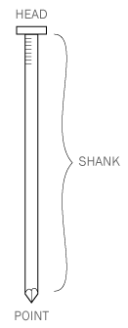
2. Nails: Parts of a nail:

Slide 12
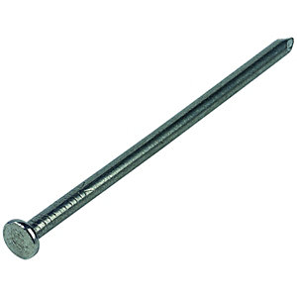
1.1 Round wire:
Uses:
General use where the visible head does not matter.
Carpentry e.g. roof trusses.

Slide 13
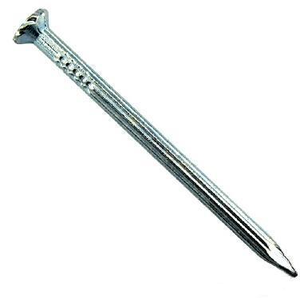
1.2 Masonry:
Uses:
Masonry nails can be used to secure shelf brackets or hanging supports to
a brick or concrete wall, and they can be used to fasten down a heavy
appliance that you want firmly anchored on a concrete floor.
These often have fluted or spirally threaded shanks and are much harder
than regular steel nails. They will not bend, but they will break if not hit
square on the head and driven straight in.

Slide 14
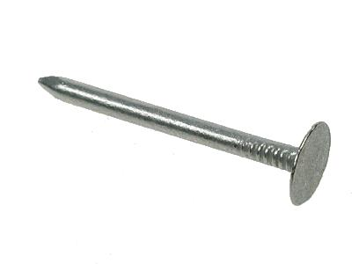
1.3 Clout nail:
Uses:
One common use for these nails is to fasten sheet metal to
wood, for example when metal is used for siding or roofing.
Can be used for a wide variety of exterior and interior
woodworking and building purposes, like furniture repair,
cabinet making, fastening roof shingles, as well as box and
crate construction.

Slide 15
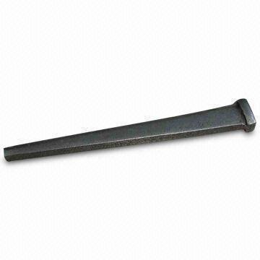
1.4 Steel cut nail:
Uses:
Mild steel cut nails are used on softwoods, such as floor
boards.
Steel cut nails are used in concrete or brickwork.

Slide 16
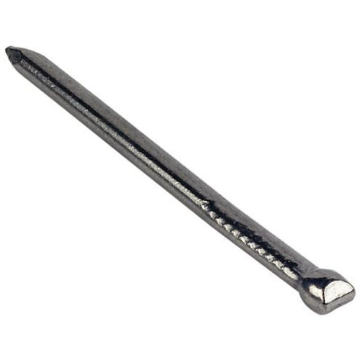
1.5 Oval nail:
Uses:
The broad side is placed with the grain to avoid splitting the wood.
Meant for wood that split easily.
For mouldings.

Slide 17
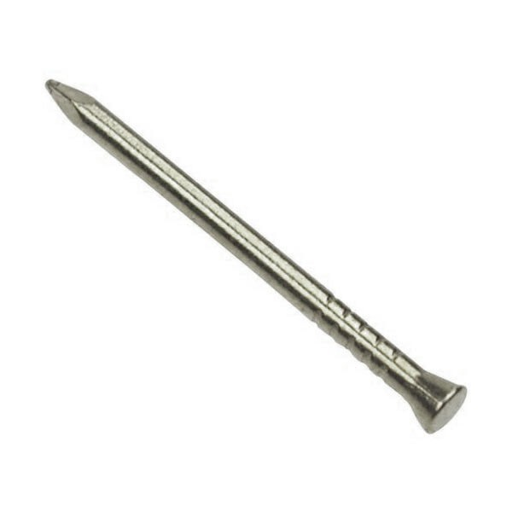
1.6 Panel nail:
Uses:
Where a large head would be unsuitable.
In wood that easily cracks.

Slide 18
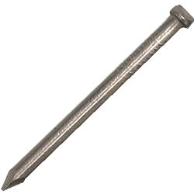
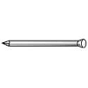
1.7 Brad nails:
Uses:
Brad nails are generally used in trim carpentry where the carpenter works
on doors, casings, or mouldings.
Can be driven into the surface of wood materials through the use of air
compressor-powered nail guns.

Slide 19
2. Advantages of using nails over screws:
Cheap.
Easy to use.
Quick method of fixing.
No expensive tools are needed.
When the head is not driven beneath the surface of the
stock, it can easily be removed.

