Slide 1
Natural Sciences and Technology Grade 6
Term 2: Matter and Materials
Solutions as special mixtures

Slide 2
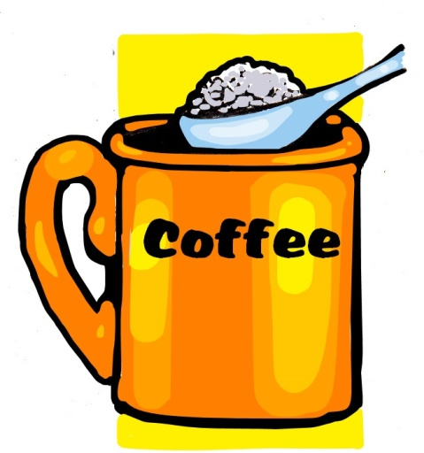
Topic 3 Solutions as special mixtures
Soluble substances
Gr 6 Natural Sciences and Technology – Term 2, Topic 3

Slide 3
Soluble substances (solutes)
Soluble substances (solutes) are substances that can dissolve in water.
Once a solution has been made, the substances (materials) cannot be easily separated again by methods such as:
sieving,
filtering,
settling, and
decanting.
Gr 6 Natural Sciences and Technology – Term 2, Topic 3

Slide 4
Soluble substances (solutes)
Some solutions can be recovered (separated) by evaporating the solvent.
For example: recovering salt from sea water.
Gr 6 Natural Sciences and Technology – Term 2, Topic 3

Slide 5
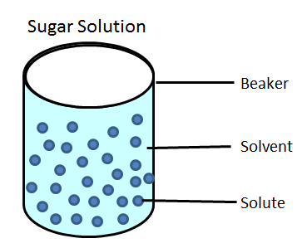
Soluble substances (solutes)
When substances dissolve,
solute particles become
equally dispersed
in the spaces
between the solvent particles.
Gr 6 Natural Sciences and Technology – Term 2, Topic 3

