Slide 1
Natural Sciences: Matter and materials
METHODS OF SEPARATING MIXTURES
GRADE 7
TERM 2

Slide 2
Topic :

Slide 3
What are we going to learn?
Methods of separating substances in a mixture (based on different physical properties)
Hand sorting
Sieving
Filtration
Using a magnet
Evaporation
Distillation
Chromatography

Slide 4
What we already know
A mixture consists of at least two different substances of material mixed together.
A solution is a mixture of a dissolved solid and a liquid.
When a gas cools and becomes a liquid, we call this change condensation.

Slide 5
New words
Sieving: separation mixtures with a sieve, using the property of size
Filtration: separating mixtures with a filter, using the property of size

Slide 6
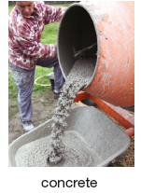
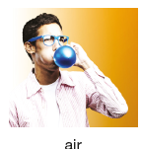
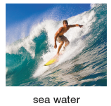
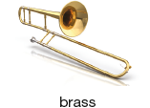
Mixtures and methods of physical separation
Mixtures consist of at least two different substances or materials mixed together.
Some common examples of mixtures are air, sea water, concrete and brass.
Air is a mixture of gases – mainly nitrogen, oxygen and a little carbon dioxide.
Concrete is a mixture of lime, cement, sand, stone and water .
Brass is a mixture of copper and zinc.

Slide 7
Let’s do it together: Activity 1 (Activity from Oxford Successful Natural Sciences Grade 7 page 64)
Define a mixture.
Give three of your own examples of mixtures.
Copy and complete the table for the mixture example above:

Slide 8
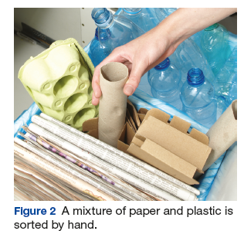
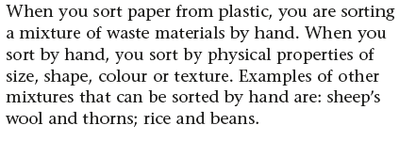
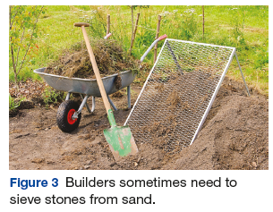
Methods of physical separation
The physical properties of the materials in a mixture determine the separating method that you use.
Hand sorting:
Sieving

Slide 9
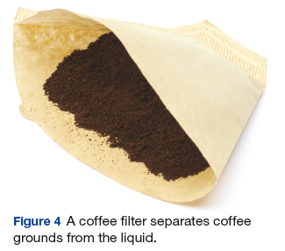
Methods of physical separation…cont
Filtration
Filtration is a method of separating mixture with particles of different sizes using a filter
The difference between a filter and a sieve is the size of the wholes
The holes in a filter are too small to see
A filter is normally made of paper, cloth or plastic
When you filter a mixture of a solid and a liquid, the liquid part goes through, and the solid part stays on the filter paper
Examples of mixtures that can
be separated by filtration are:
sand and water, coffee grounds
and water

Slide 10
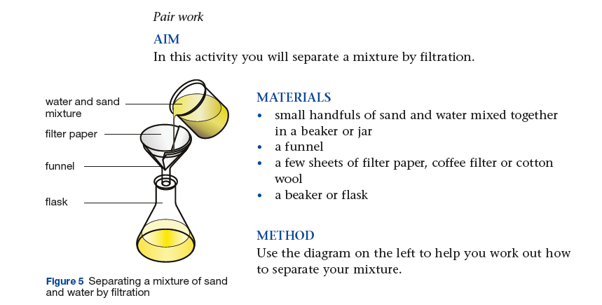
Let’s do it together: Practical Activity (Activity from Oxford Natural Sciences Grade 7 LB page 66)

Slide 11
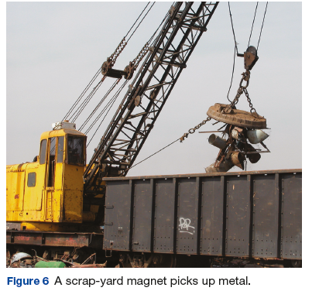
Using a magnet
What if it is too slow or difficult or dangerous to sort a particular material by hand?
A magnet is useful for materials with magnetic properties.
The photograph shows a giant scrapyard magnet that is used to sort scrap metals.

Slide 12
Using a magnet…cont
Metals such as iron, steel and nickel are attracted to magnets.
Metals such as copper and aluminium are not
Non-metals such as plastic and glass are also not attracted to magnets.
Examples of other metals that can be sorted by magnets are: iron, filings of sand and iron nails from broken glass.

Slide 13
Let’s do it together: Practical activity 3 (Activity from Oxford Successful Natural Sciences Grade 7 LB page 67)

Slide 14
Evaporation
We’ve seen how to separate solids.
How do we separate a solution?
How do we get salt out of water?
We do it by evaporation.
Evaporation is the process of separating a liquid or solvent part (like water) into a gas (water vapour).
When you evaporate salt water, the crystals of salt are left behind.
This is called a solute.

Slide 15
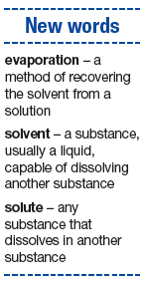
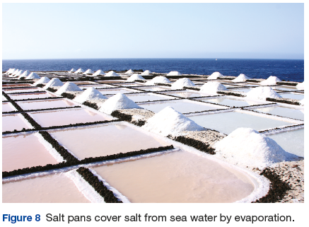
Evaporation…cont
The Cerebos salt factory in Coega retrieves the salt from sea water by evaporation.
Sea salt is held in shallow evaporating pans or ponds.
The salt is collected once the water has evaporated.

Slide 16
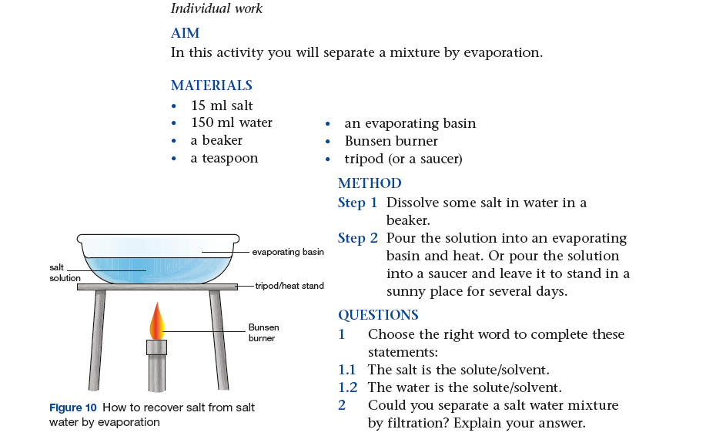
Let’s do it together: Practical activity 4

Slide 17
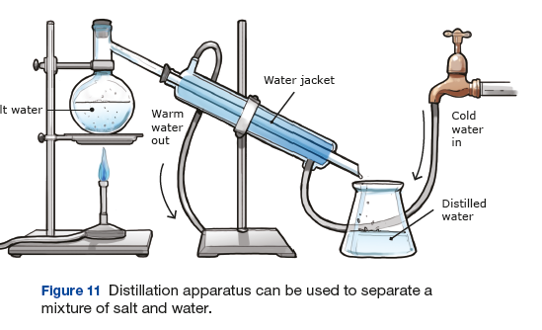
Distillation
What if, instead of salt you want to get pure water from sea water?
You could do it by distillation.
Distillation is a method that combines boiling and condensation.
It separates substances with different boiling points.
The figure below shows the distillation apparatus.
The solution is heated so that the solvent (water) boils and becomes a gas (water vapour)

Slide 18
Distillation
The gas is collected in a long tube called a Liebig condenser
The jacket is cooled by a jacket of cold water, which cools down the gas.
The gas condenses back to a liquid (pure water) and it is collected in the flask
The solute (salt) is left behind.

Slide 19
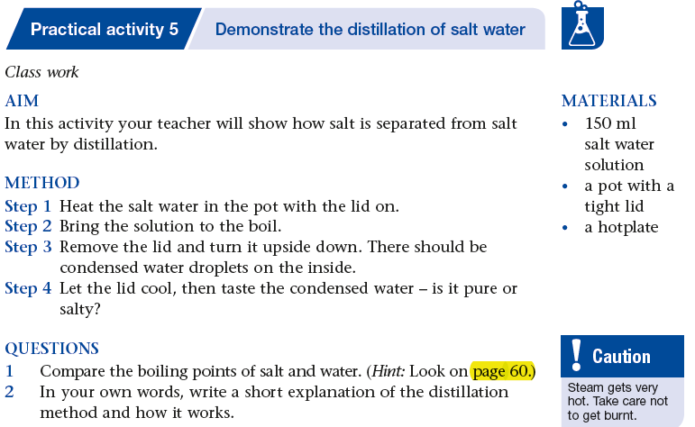
Let’s do it together: Practical Activity 5 (Activity from Oxford Successful Natural Sciences Grade 7 LB page 68)

Slide 20
Chromatography
Chromatography is a method of separating a solution of different colours.
Black ink is an example of a mixture of colour pigments in water.
Chromatography involves spotting of a mixture of colours onto filter paper.
The colour sticks to the paper and then spread out on the paper, carried by a solvent.
Some colours stick to the paper more strongly than other ‘s.

Slide 21
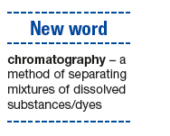
Chromatography
The more strongly the colour sticks, the slower and less further it travels.
The less strongly a colour sticks, the faster and further it travels.

Slide 22
Let’s do it together: Practical activity 6 (Activity from Oxford Successful Natural Sciences Grade 7 LB page 69)

Slide 25
Let’s revise
What does a mixture consist of?
Answer: At least two different substances of material mixed together
2. Explain what a solution is.
Answer: A mixture of a dissolved solid and a liquid
3. What happens when a gas cools?
Answer: It becomes a liquid, we call this change condensation
4. Explain the mixture of air.
Answer: It is a mixture of gases, mainly nitrogen, oxygen and a
little carbon dioxide.

Slide 26
Let’s revise
5. Name the different method of separation.
Answer: hand sorting, sieving, using a magnet, evaporation, distillation chromatography
6. When will you use hand sorting as a method of physical separation
Answer: When we sort plastic from paper
7. Explain what filtration is
Answer: A method of separating a mixture with particles of different sizes using a filter
8. Where and why will a magnet be used for sorting?
Answer: In a giant scrapyard when it is too slow or too dangerous to sort a particular material by hand

Slide 27
Let’s revise
9. Explain what evaporation is?
Answer: It is the process of separating a liquid or solvent (like water) into a gas (water vapour).
10.Explain what a solute is.
Answer: When we evaporate salt water, the crystals of salt that are left behind is called a solute.
11. When will we use distillation as a method of separating mixtures?
Answer: When we want to get pure water from sea water.

Slide 28
Questions

