Slide 1
PowerPoint
Lesson 1

Slide 2
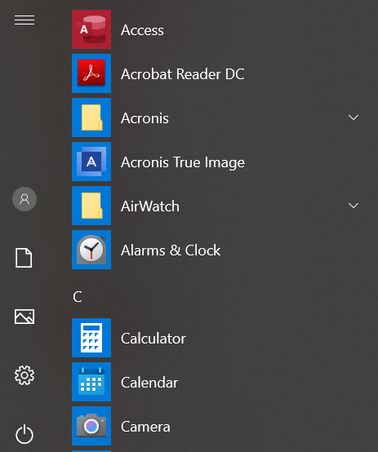
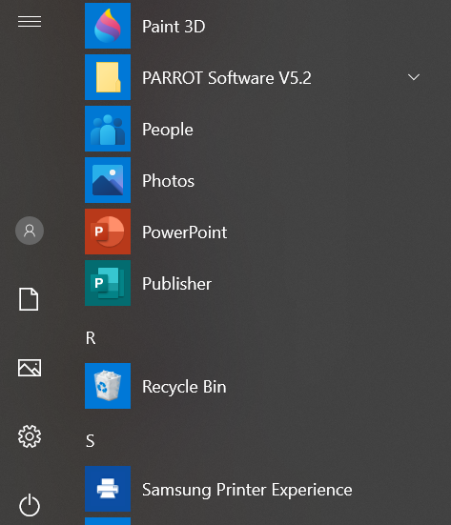
1. Click on the Microsoft Office Button to start
2. An alphabetic list of all your applications will appear
3. Scroll down and click on PowerPoint. (You might need to click Programs first)
Start
PowerPoint

Slide 3
4. Click Blank Presentation
5. A new blank presentation appears, containing a single Title Slide
6. By default, in PowerPoint, the title slide offers two text boxes for a title and subtitle
Start
PowerPoint (Cont’d)

Slide 4
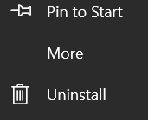
Pin PowerPoint to the Taskbar and start PowerPoint from the Taskbar
1. Click on the Microsoft Office Button to start
2. From the alphabetic list, browse to PowerPoint
3. Right-click on PowerPoint, and then select More

Slide 5
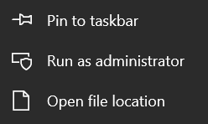
Pin PowerPoint to the Taskbar and start PowerPoint from the Taskbar (Cont’d)
4. Select Pin to taskbar
5. The icon appears on the taskbar
6. Click on the icon on the taskbar to open PowerPoint

Slide 6
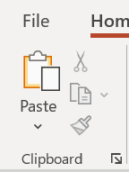
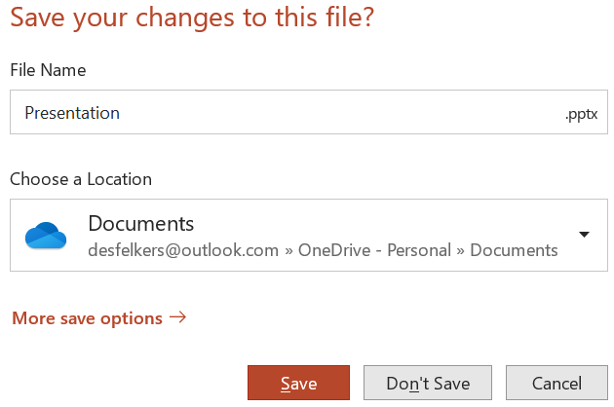
Close a Presentation
1. Choose File > Close (The PowerPoint program will remain open although the presentation is closed)
2. A dialogue box will open that reminds you that any changes you've made to the presentation have not been saved
3. If you don't want to save the changes, click the Don't Save button, or Cancel if you don't want to close the presentation
4. You can also close the Presentation by clicking the Close button, the in the upper-right corner of the PowerPoint window

Slide 7
1. When you launch PowerPoint, a new blank presentation appears, containing a single Title Slide
2. You will see distinctive boxes with dotted borders (placeholders) into which you can add some content
3. All built-in slide layouts that come with PowerPoint contain placeholders
What is a
Placeholder?

Slide 8
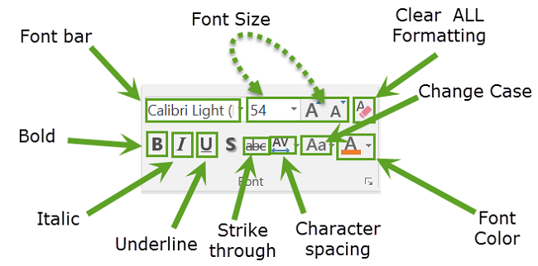
The PowerPoint Ribbon
The Ribbon is divided into TABS
Each TAB holds separate GROUPS
Click an ARROW for more GROUP COMMANDS
Contextual TABS will appear when certain items are selected
Each GROUP holds separate COMMANDS

Slide 9
It's important to save your presentation whenever you start a new one or make changes to an existing one
Saving early and often can prevent your work from being lost
You'll need to pay close attention to where you save the presentation so it will be easy to find later
Why do we save a
Presentation?

Slide 10
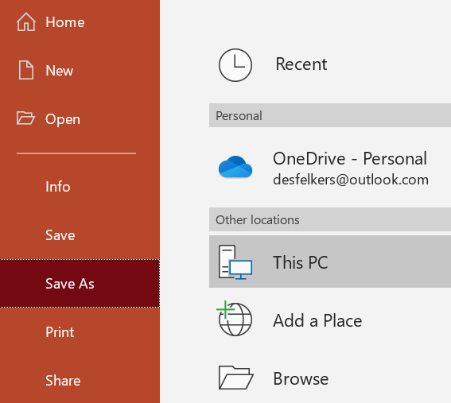
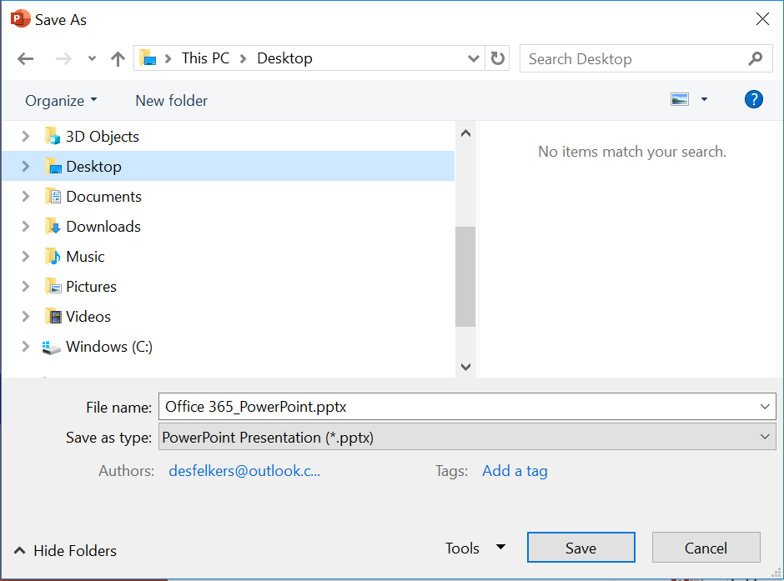
1. Click File > Save As > Browse
2. Specify a location, a filename and the format you want to save the file in
Save a Presentation
for the first time

Slide 11
3. Specify the correct folder in the left pane
4. Type the name for your file in the File name field
5. In the Save as type box: Choose the default file format that appears with the default file extension (.pptx)
6. Click Save
7. Close the Presentation
Save a Presentation
for the first time (Cont’d)

Slide 12
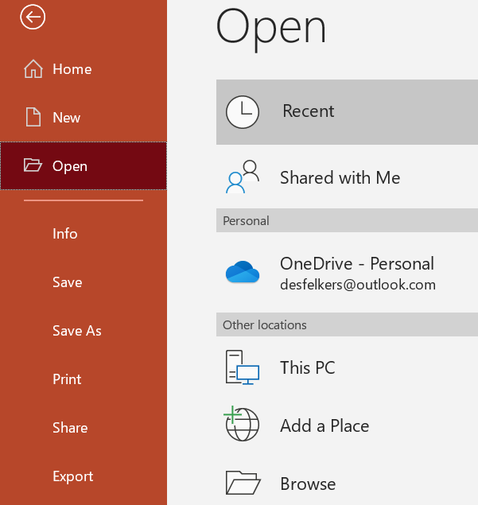
1. Click on the PowerPoint icon on the TASKBAR to open PowerPoint
2. From within PowerPoint, you will now open a .pptx file
3. Choose File > Open > Browse
Launch PowerPoint
and open an existing
presentation

Slide 13
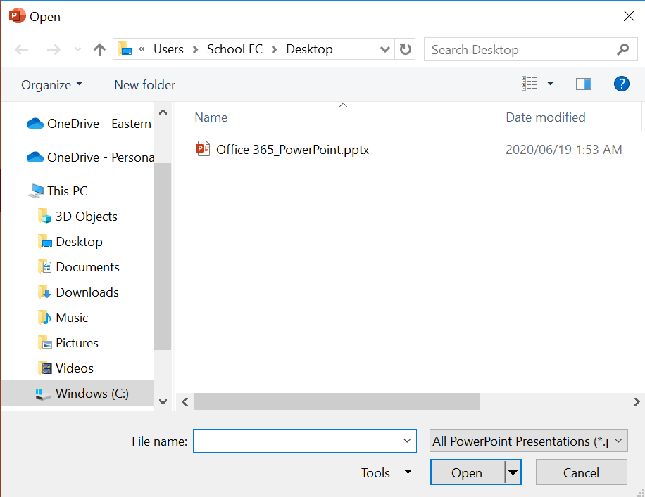
Launch PowerPoint and open an existing presentation (Cont’d)
4. From the Open Dialogue box, locate the file
5. Double-click on the file or click on the file and then click Open

Slide 14
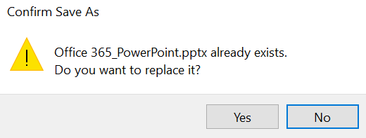
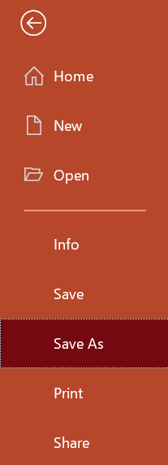
1. Clicking Save will enable you to save the file under its current name and keep it saved at its current location
2. When you click Save, and another file of the same name exists, PowerPoint will prompt you to either enter a new file name or to replace the existing copy with the new version you are currently saving
3. If you want to save the file under a new name, and to a new location, you must choose File > Save As
Save the file under its current name and keep it saved at its current location

Slide 15
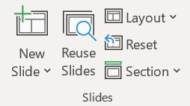
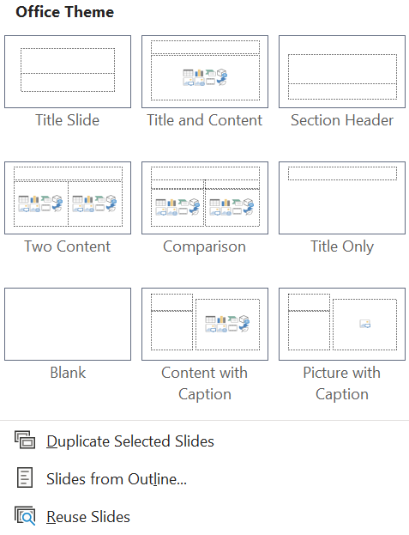
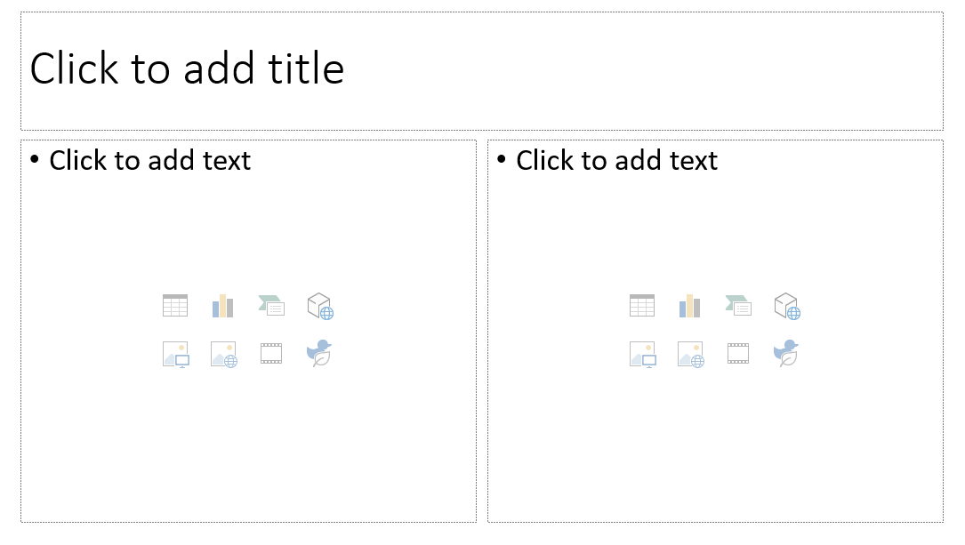
1. From the Home tab, in the Slides Group, click on the down arrow next to the New Slide command
2. Choose the "Two Content" slide layout from the menu that appears
3. The new "Two Content" slide will appear
Insert a new slide
(Two Content)

Slide 16
1. From the Home tab, in the Slides Group, click on the down arrow next to the New Slide command
2. Choose the "Blank" slide layout from the menu that appears
3. The new "Blank" slide will appear
Insert a new
Blank slide

Slide 17
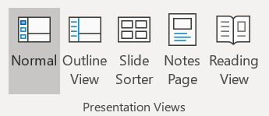
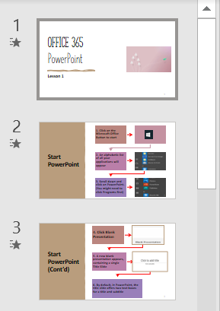
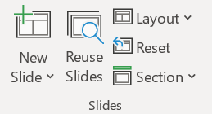
1. On the View tab, in the Presentation Views group, click "Normal" to set the view to normal
2. In Normal View, in the Slide Navigation Pane on the left, click on the slide you want to change to a different layout
3. On the Home tab, In the Slides Group, click Layout and select the layout you prefer
Change the layout
of your slide

Slide 18
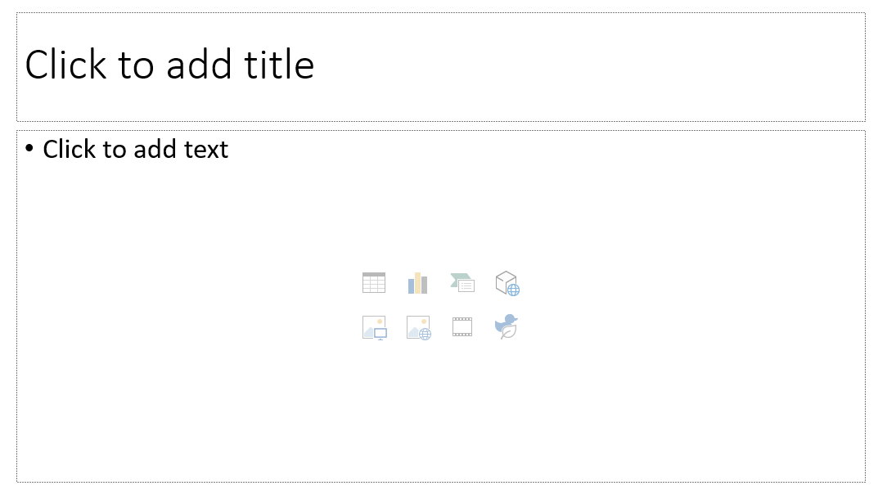
1. Click into the text and title placeholders that are part of the slide layout and start typing text
2. A border composed of dashes means that the object is in “text edit” mode
3. In this mode, you may select and change text inside the object
Add text to a
Placeholder

Slide 19
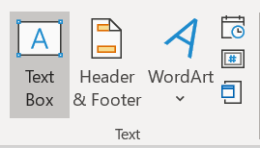
1. Click the Insert tab on the Ribbon. Then click the Text Box button in the Text group
2. Click and drag over the area in the slide where you want to insert the text box. Release your mouse to insert the text box (in text edit mode)
3. You must immediately type some text, or the text box will be deleted when you click away from it
Add additional text
to text boxes

Slide 20
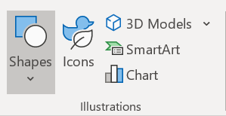
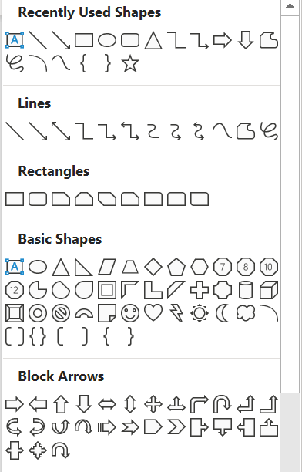
1. On the Insert tab in the Ribbon, click the Shapes button in the Illustrations group.
2. Click the desired shape from the drop-down menu of choices
3. Click and drag over the area in your slide where you want to place the shape. The Shape inserts itself when you release your mouse and it appears selected in the slide when it is inserted. Simply type the text you want to add to the selected shape.
Add additional text
to shapes

Slide 21
The advantage of adding text to Slide Placeholders
The text added to placeholders will appear in the presentation’s Outline view
Text added to text boxes and shapes will NOT appear in the presentation’s Outline view

Slide 22
1. Click in the placeholder where you want to enter the sample text
Type =RAND(5,5)
2. The numbers will tell PowerPoint to create a certain number of paragraphs (the first number) consisting of a certain number of sentences (the second number)
3. Press Enter on the keyboard. 5 paragraphs, each consisting of 5 sentences will appear in your slide
=Rand(5,5)
Enter sample text in
MS PowerPoint?

Slide 23
= Rand(5,10) 5 paragraphs, each consisting of 10 sentences
The quick brown fox jumps over the lazy dog. The quick brown fox jumps over the lazy dog. The quick brown fox jumps over the lazy dog. The quick brown fox jumps over the lazy dog. The quick brown fox jumps over the lazy dog. The quick brown fox jumps over the lazy dog. The quick brown fox jumps over the lazy dog. The quick brown fox jumps over the lazy dog. The quick brown fox jumps over the lazy dog. The quick brown fox jumps over the lazy dog.
The quick brown fox jumps over the lazy dog. The quick brown fox jumps over the lazy dog. The quick brown fox jumps over the lazy dog. The quick brown fox jumps over the lazy dog. The quick brown fox jumps over the lazy dog. The quick brown fox jumps over the lazy dog. The quick brown fox jumps over the lazy dog. The quick brown fox jumps over the lazy dog. The quick brown fox jumps over the lazy dog. The quick brown fox jumps over the lazy dog.
The quick brown fox jumps over the lazy dog. The quick brown fox jumps over the lazy dog. The quick brown fox jumps over the lazy dog. The quick brown fox jumps over the lazy dog. The quick brown fox jumps over the lazy dog. The quick brown fox jumps over the lazy dog. The quick brown fox jumps over the lazy dog. The quick brown fox jumps over the lazy dog. The quick brown fox jumps over the lazy dog. The quick brown fox jumps over the lazy dog.
The quick brown fox jumps over the lazy dog. The quick brown fox jumps over the lazy dog. The quick brown fox jumps over the lazy dog. The quick brown fox jumps over the lazy dog. The quick brown fox jumps over the lazy dog. The quick brown fox jumps over the lazy dog. The quick brown fox jumps over the lazy dog. The quick brown fox jumps over the lazy dog. The quick brown fox jumps over the lazy dog. The quick brown fox jumps over the lazy dog.
The quick brown fox jumps over the lazy dog. The quick brown fox jumps over the lazy dog. The quick brown fox jumps over the lazy dog. The quick brown fox jumps over the lazy dog. The quick brown fox jumps over the lazy dog. The quick brown fox jumps over the lazy dog. The quick brown fox jumps over the lazy dog. The quick brown fox jumps over the lazy dog. The quick brown fox jumps over the lazy dog. The quick brown fox jumps over the lazy dog.

Slide 24
=Rand(4,8) 4 paragraphs, each consisting of 8 sentences
The quick brown fox jumps over the lazy dog. The quick brown fox jumps over the lazy dog. The quick brown fox jumps over the lazy dog. The quick brown fox jumps over the lazy dog. The quick brown fox jumps over the lazy dog. The quick brown fox jumps over the lazy dog. The quick brown fox jumps over the lazy dog. The quick brown fox jumps over the lazy dog.
The quick brown fox jumps over the lazy dog. The quick brown fox jumps over the lazy dog. The quick brown fox jumps over the lazy dog. The quick brown fox jumps over the lazy dog. The quick brown fox jumps over the lazy dog. The quick brown fox jumps over the lazy dog. The quick brown fox jumps over the lazy dog. The quick brown fox jumps over the lazy dog.
The quick brown fox jumps over the lazy dog. The quick brown fox jumps over the lazy dog. The quick brown fox jumps over the lazy dog. The quick brown fox jumps over the lazy dog. The quick brown fox jumps over the lazy dog. The quick brown fox jumps over the lazy dog. The quick brown fox jumps over the lazy dog. The quick brown fox jumps over the lazy dog.
The quick brown fox jumps over the lazy dog. The quick brown fox jumps over the lazy dog. The quick brown fox jumps over the lazy dog. The quick brown fox jumps over the lazy dog. The quick brown fox jumps over the lazy dog. The quick brown fox jumps over the lazy dog. The quick brown fox jumps over the lazy dog. The quick brown fox jumps over the lazy dog.

Slide 25
Selecting Text
To select a single word:
Double-click the word (click the left mouse button twice in rapid succession)
To select a line of text:
To select a sentence:
Hold the CTRL key and CLICK anywhere in the sentence
To select a paragraph:
TRIPLE CLICK (click the left mouse button 3 times in rapid succession) anywhere in the paragraph
To select all text on a slide:
Press [Ctrl] + [A] on the keyboard to highlight the content on the entire slide
Place your cursor at the start of the line, and press Shift + down arrow

Slide 26
Know your
keyboard

Slide 27
Go to the beginning of the presentation:
Press [Ctrl] + [Home] on your keyboard to go to the beginning of the presentation
Press [Home] to go to the beginning of a LINE

Slide 28
Go to the end of the presentation:
Press [Ctrl] + [End] on your keyboard to go to the end of the presentation
Press [End] to go to the end of a LINE

