Slide 1
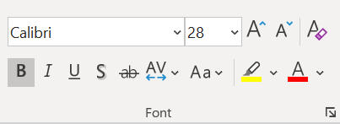
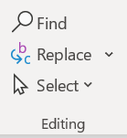
PowerPoint
Lesson 3

Slide 2
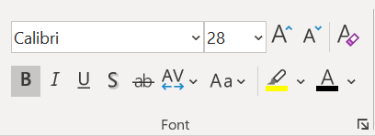
Once you've added text to the slide, you might want to change how it appears. Select the text…
Change
Font Appearance
Bold
Use this option to make your text heavier and thicker
Italic
Use this option to make your text look "lean“.
It is great for captions or annotations
Underline
Use this option to add a horizontal line below your text.
Font
Click the arrow to scroll through and choose from different typefaces like Arial, Times New Roman, or a custom font

Slide 3
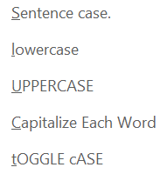
Once you've added text to the slide, you might want to change how it appears. Select the text…
Change
Font Appearance
(Cont’d)
Shadow
When your text needs contrast to stand out from the slide, add a shadow to make it more readable
Strikethrough
A strikethrough is a horizontal line through the center of your text, making it appear crossed out
Change Case
This tool is a major timesaver for converting text between "cases", such as UPPERCASE, lowercase, Sentence case, etc. If you have all uppercase text for example, you can change it to appear more natural

Slide 4
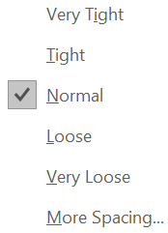
Once you've added text to the slide, you might want to change how it appears. Select the text…
Change
Font Appearance
(Cont’d)
Character Spacing
In the Spacing box, select the desired line spacing option from the menu. This is also sometimes called kerning, and it describes how much space is between each character in your text: Tight, Normal, Loose, Very Loose

Slide 5
Once you've added text to the slide, you might want to change how it appears. Select the text…
Change
Font Appearance
(Cont’d)
Font Size: Click the arrow to scroll through and select the Font Size that you want or, select the number in the box, enter the font size you want, and press ENTER. The higher the number, the larger the text
Increase Text Size: Use this command to make your text- size larger
Decrease Text Size: Use this command to make your text- size smaller
Clear Formatting:
Use this command to remove all formatting from your selection, leaving only the normal, unformatted text

Slide 6
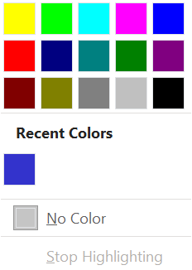
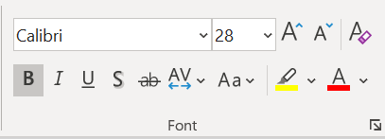
3. Choose a colour. The text you selected will be highlighted in the colour you chose
2. On the Home tab, in the Font Group, click the arrow next to Text Highlight Color
1. Select the text you want to highlight
Note: Use a light highlight colour if you plan to print the presentation
Make your text pop
by highlighting it in
a bright colour

Slide 7
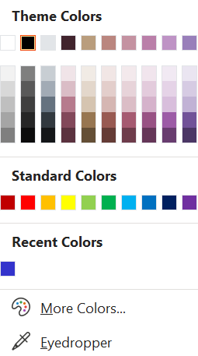
2. The coloured line under the letter A button indicates the current colour
1. Select the text. On the Home tab, in the Font Group, click the Font Color button (the letter A button)
4. You may choose a standard colour shown or click the More Colors... button to see other options. De-select the text to see the effect
Change the colour
of your text
3. If this is the colour you want to use, simply click the button. To change to a different font colour, click the drop-down arrow beside the button to display other colour choices

Slide 8
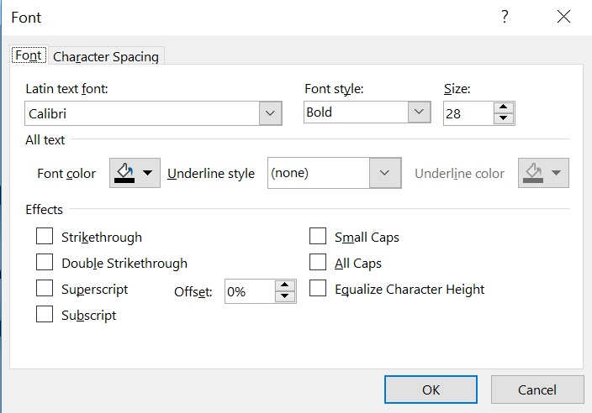
Dialog launcher
within the Font group

Slide 9
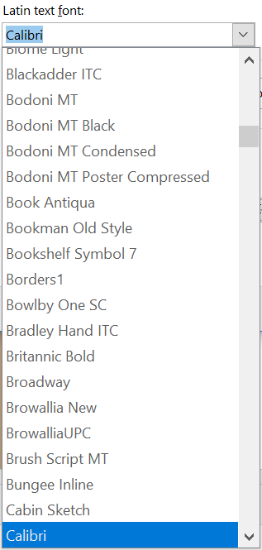
Dialog launcher
within the Font group
(Cont’d)
Latin text font
Click the down-arrow to bring up a list of installed fonts
Choose any font typeface available within Latin text font list

Slide 10
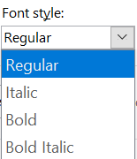
Dialog launcher
within the Font group
(Cont’d)
Font style
This option brings up a drop-down list from where you can choose a font style such as Bold, Italics, Bold Italics, etc. for your selected text

Slide 11
Dialog launcher
within the Font group
(Cont’d)
Size
Use the up or down arrows to increase or decrease the font size.
You can also select the number in the box, enter the font size you want, and press ENTER. The higher the number, the larger the text.

Slide 12
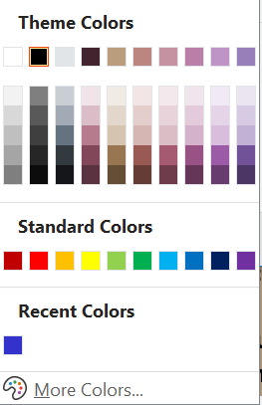
Dialog launcher
within the Font group
(Cont’d)
Font color
Change the colour of selected text

Slide 13
Dialog launcher
within the Font group
(Cont’d)
Underline style
PowerPoint offers 16 underline styles for text, such as: single line, double line, dotted line, wavy line, etc.

Slide 14
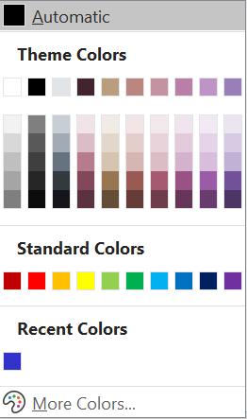
Dialog launcher
within the Font group
(Cont’d)
Underline color
Here you can select a colour for the underline.
Note that this option will be only active when underline style is applied to the text.

Slide 15
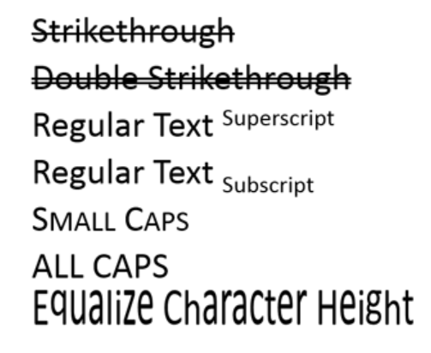
Effects
Select the required Effects check-box(es) to apply to the selected text.
Once the options are chosen, click the OK button within the Font dialog box.
Dialog launcher
within the Font group
(Cont’d)

Slide 16
Once the options are chosen, click the OK button within the Font dialog box to apply the changes to the selected text
Dialog launcher
within the Font group
(Cont’d)

Slide 17
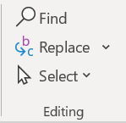
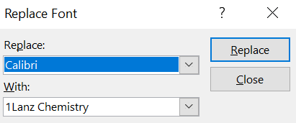
1. On the Home tab, in the Editing group, click the Replace dropdown arrow (don't just select replace)
4. Select the Font Style you want to replace it with (With:) The With drop down arrow shows you all the available font styles on your computer
5. Click Replace
2. Select Replace Fonts
3. Click the Font Style you want to replace (Replace:) The Replace drop down arrow will only show you a list of the font styles that are currently within your presentation
Change the font
on ALL slides

